Slide 1
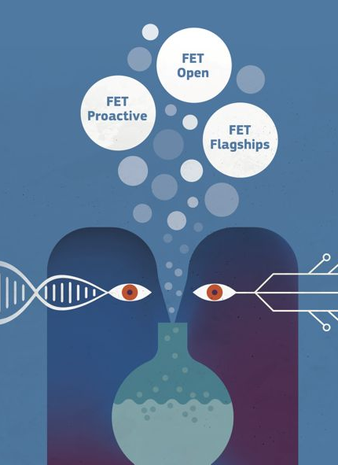
EU Research Framework Programmes
FP7, H2020, ‘FP9’ & HR participation
Ivica Ćubić
02/11/2017

Slide 2
Content
FP7
  Key figures & facts
  Structure
  ‘White box’ evaluation
  HR in FP7
Horizon 2020
  Structure
  EU-13/HR participation
‘FP9’
  ‘Lamy’s report’

Slide 3
7th Framework Programme (FP7)
2007-2013
EU contribution 50.6 billion EUR
487 calls, 136k proposals, 601k applicants
25k projects (19%), 130k beneficiaries (22%)
  86% member states
  8% candidate and associated countries
  6% third countries
Main beneficiaries are higher and secondary education institutes
Small and medium enterprises (SMEs) 46% of all industry organisations

Slide 4
FP7 structure
Cooperation – funding for collaborative, transnational research
  Information and Communication Technologies (ICT)
    Future & Emerging Technologies (FET)
  Nanosciences, Nanotechnologies, Materials and new Production Technologies (NMP)
  Health
  Energy
  Transport
  Socio-economic Sciences and Humanities (SSH)

Slide 5
FP7 structure (Cont)
Ideas – individual frontier research
  ERC grants
    starting, advanced, consolidator, synergy, proof-of-concepts
People – improve the training, career development, and mobility of researchers
  Marie Curie
Capacities – improve Europe’s research infrastructure and the research capacities of SMEs
EURATOM
Joint Research Centre (JRC) – EC’s in-house science service
Notes:
Izvadak iz strukture FP7

Slide 6
FP7 budget breakdown
Notes:
FP7 EURATOM budget of € 2,7 billion over 5 years not included

Slide 7
Ex-post evaluation of FP7
‘White box’ view
5 evaluation criteria ('Better Regulation’ guidelines)
Effectiveness
  Increase the competitiveness & positive impacts on growth and jobs
    Indirect economic affects over the next 25 years
    Public-private partnerships including the joint technologies initiatives (pharmaceuticals, aeronautics and fuel cells and hydrogen)
    130k research jobs/year
  Strengthening scientific excellence
    Open access >54% of scientific peer reviewed publications (+170k)
    some programmes have 30% publications among the 5% of highly-cited publications in their disciplines
  Increase of Europe-wide research collaboration
  Increase the level of research investment
Notes:
Ex-post evaluation 19/01/2016. Commission Staff Working Document (kako to komisija vidi)-
Necu govoriti o konkretnim brojcanim procjenama utjecaja na BDP i novo stvorenim poslovima jer ne znam metodologiju kako je to izracunato. Za razliku od toga vrlo konkretan broj je 130k istrazivackih poslova godisnje.

Slide 8
Ex-post evaluation of FP7 (Contd)
‘White box’ view
Efficiency
  Simplification (still unsatisfactory)
Relevance
  Responded to the economic crisis
  Addressed relevant societal challenge
    E.g. food safety, climate change, health and socio economic issues (migration, radicalisation)
Coherence
  Coherent with other EU policy initiatives
    the Competitiveness and Innovation Programme, the Structural funds
  The knowledge-base to support EU policies
EU added values
  Joint efforts, additionality, networking
Notes:
FP7 ensured additionality, meaning that only a small minority of projects would have gone ahead in its absence.

Slide 9
HR in FP7
Average success rate (2017-2013)
  16.9% applicants, 11.1% EU contribution (HR)
  21.6% applicants, 19.2% EU contribution (EU)

Slide 10
HR in FP7 (Contd.)
Applicants (counts) & EU contribution (MEUR)
  68/39/41/76/63/48/53/388 (HR)
  9.1/8.3/7.1/12.3/11.0/13.7/12.6/74.2 (HR)
Notes:
Razlicite boje su doprinosi po godinama

Slide 11
HR in FP7 (Contd.)
Average EU contribution per applicant (2017-2013) (kEUR)

Slide 12
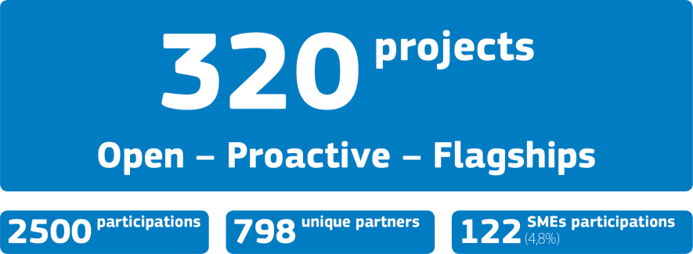

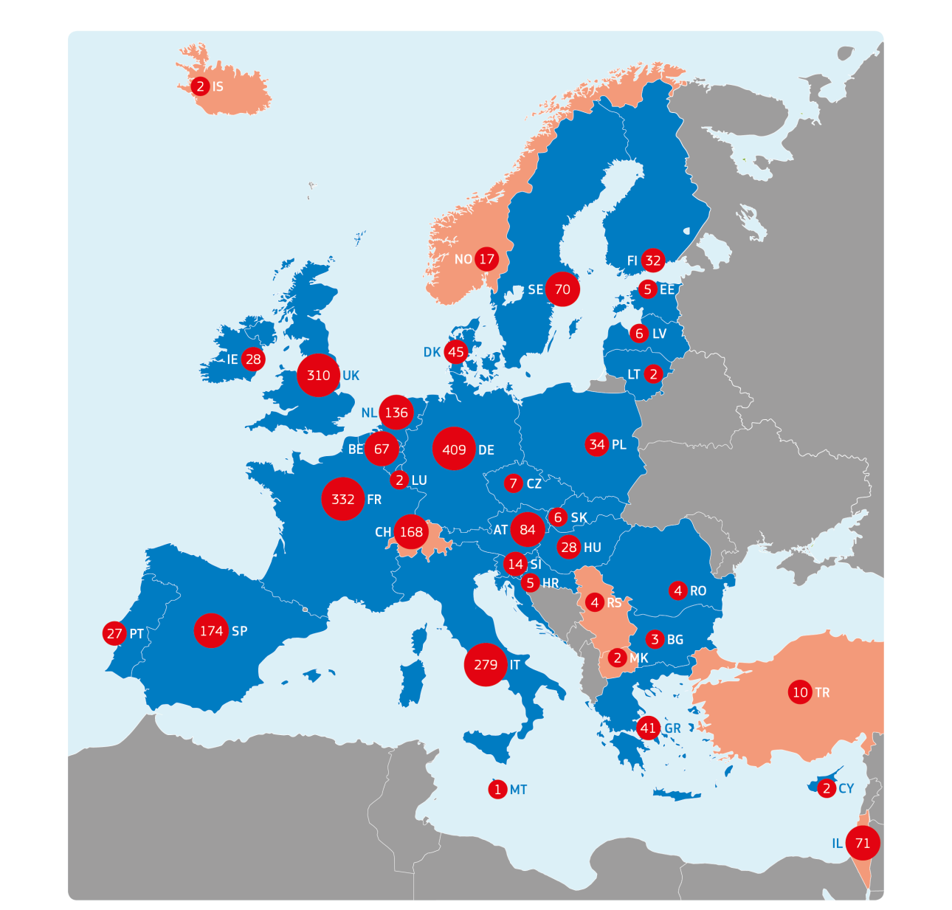
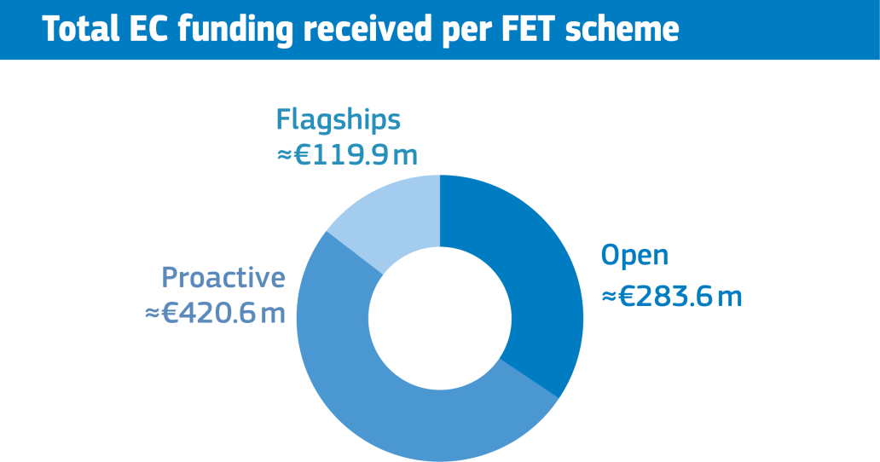

FET in FP7

Slide 13
Horizon 2020 (‘FP8’) 2014-2020
A stronger, clearer focus
H2020 Budget: 77B€
(current prices)
Excellent
Science
24,4 B€
Industrial
Leadership
17B€
Societal
Challenges
29,6 B€
OTHERS: 5,8B€ (Spreading excellence & widening participation, Science & Society, JRC, EIT)

Slide 14
Excellent Science pillar in H2020
European Research Council (13B€)
Marie Skłodowska-Curie actions (6,1B€)
Future and Emerging Technologies (2.7B€ )
Research infrastructures programme (2,4B€)
"Future and emerging technologies shall support collaborative research in order to extend Europe’s capacity for advanced and paradigm-changing innovation.”
HORIZON 2020 - THE FRAMEWORK PROGRAMME FOR RESEARCH AND INNOVATION (2014-2020)

Slide 15
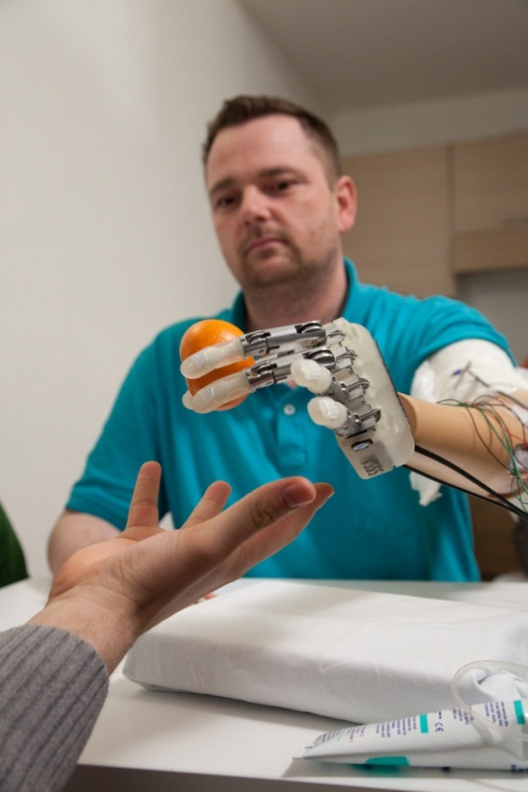
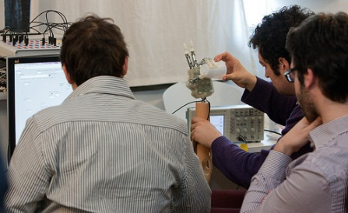
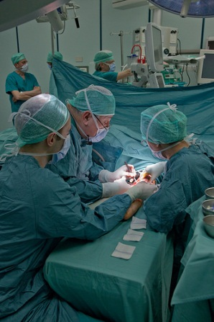

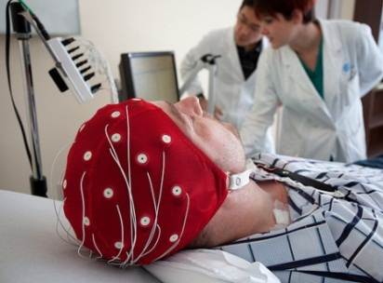

Examples of FET Projects
Building on FET interdisciplinary research
Restored real-time sensory feeling
Nebias-Project.eu
biorobotic prosthesis
algorithms and software
implant surgery
clinical and neurophysical protocols
Notes:
FET projects funded under CYBERHAND and NEUROBOTICS -> LIFEHAND & LIFEHAND2 and NEBIAS

Slide 16
HR in H2020
Stats as a baseline (EU13)
Gross domestic product (2016) at market prices (current prices, link)
  EU-13: 8,1% of all EU-28 countries
Research and development expenditure 2014 (all sectors, link):
  EU-13: 4,2% of all EU-28 countries
Total researchers (FTE) 2014 (all sectors, link):
  EU-13: 12,5% of all EU-28 countries

Slide 17
HR in H2020 (Contd.)
Participation of EU-13 in FET*
 | #applicants | #applicants (%) | #funded applicants | #funded applicants (%) | Success rate
EU-13 | 1480 | 7.0% | 84 | 5.0% | 5.7%
EU-15 | 17710 | 83.6% | 1458 | 86.8% | 8.2%
Non-EU** | 1983 | 9.4% | 137 | 8.2% | 6.9%
Total | 21173 |  | 1679 |  | 7.9%
#applicants:
  EU-13: 7.7% of all EU-28 countries
#funded applicants
  EU-13: 5.4% of all EU-28 countries
*All FET calls in 2014-2016 + CHIST-ERA III ERA-NET Cofund in 2017
** Mostly associated countries (1724) + Third countries (203) + Other (56)

Slide 18
HR in H2020 (Contd.)
Participation of EU-13 in FET*
 | Budget (MEUR) | budget (%) | #participants | #participants (%)
EU-13 | 24.00 | 4.3% | 84 | 5.0%
EU-15 | 465.92 | 83.1% | 1458 | 86.8%
Non-EU** | 71.06 | 12.7% | 137 | 8.2%
Total | 560.98 |  | 1679
H2020 EU-13 |  | 4.4%
FP7 EU-13 |  | 4.2%
budget:
  EU-13: 4.9% of all EU-28 countries
*All FET calls in 2014-2016 + CHIST-ERA III ERA-NET Cofund in 2017
** Mostly associated countries (128) + Third countries (6) + Other (3)

Slide 19
HR in H2020 (Contd.)
FET-Proactive ERA-NET Cofund – funding agencies from EU13
QuantERA
  In: PL, CZ, RO, BG, SK, SI, HU, LV
  Out: EE, LT, CY, HR, MT
CHIST-ERA III
  In: PL, CZ, RO, BG, SK, EE, LT
  Out: SI, HU, LV, CY, HR, MT

Slide 20
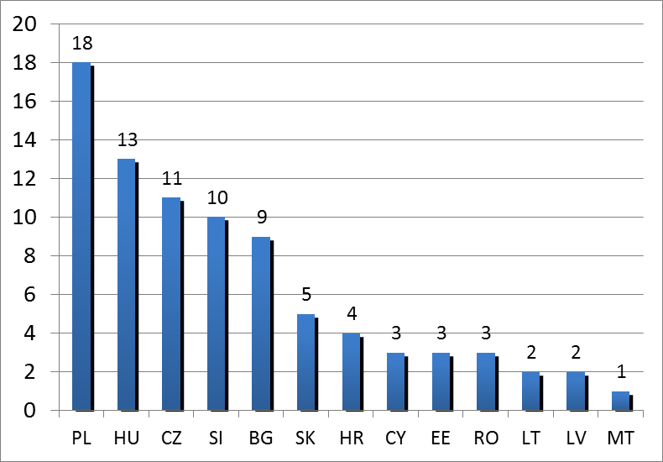
HR in H2020
FET* EU-13 participants per Member States (MS)
*All FET calls in 2014-2016 + CHIST-ERA III ERA-NET Cofund in 2017

Slide 21
‘9th Framework Programme – FP9’
Report of the independent High Level Group
on maximising the impact of EU Research & Innovation Programmes
  Chair: Pascal Lamy
  12 members: Milena Žic Fuchs (HR), Nevenka Maher(SI)
LAB – FAB – APP Investing in the European future we want
11 recommendations
  Double the budget
  Mission oriented, impact focused
  Simplify further
3 pillars: science and skills, innovation and competitiveness, global challenges

